Slide 1



Analyse functionality in ProMIS
© CBM / Trenchard

Slide 2
Analyse – Key messages
PowerBI shall be the main data visualization and analysis system for data entered in ProMIS
Analyse tool shall be for end users to support in their day-to-day operational work

Slide 3
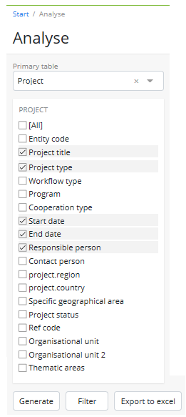
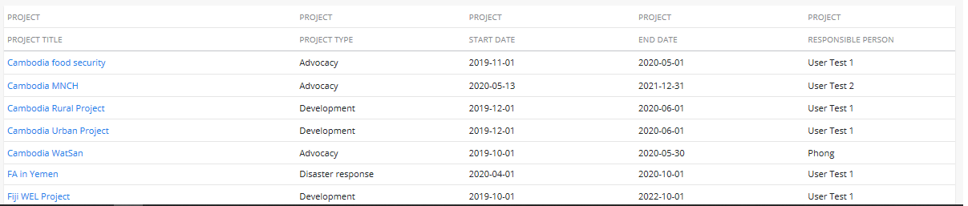
Analyse – intro
Analyse enables users to extract information that’s been input in the various forms, tables and tabs across the system
The ‘Primary table’ is selected first and a checklist appears of all the form fields of the table selected (e.g. if Project was selected, the checklist would be all the fields on the Project entity form)
The fields required in the report are ticked to be selected, think of them as columns in an Excel report
To create the report, the ‘Generate’ button is clicked and a table of data will appear at the bottom of the screen

Slide 4
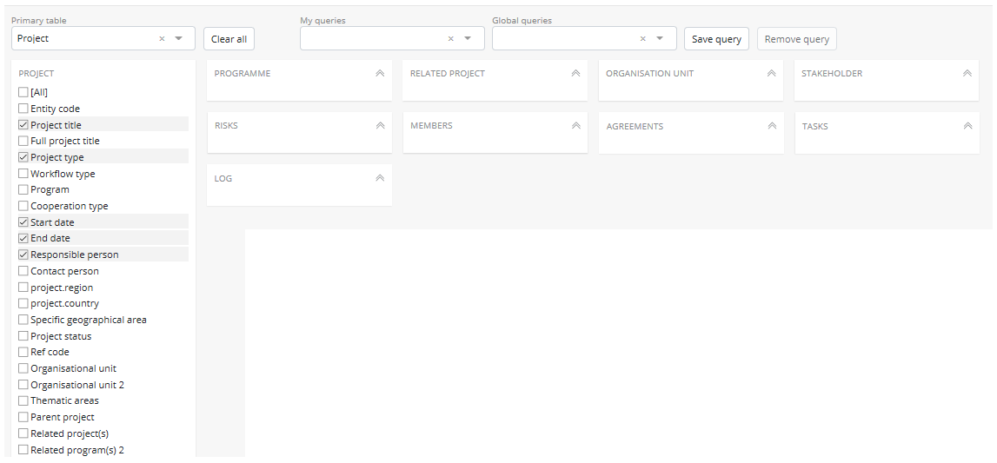
Analyse – Secondary tables
When a table is selected in the ‘Primary table’ field, a series of other tables appear as options based on that selection.
Click on any to expand the table and see the checklist within
This allows a report to be created from related data across the system

Slide 5
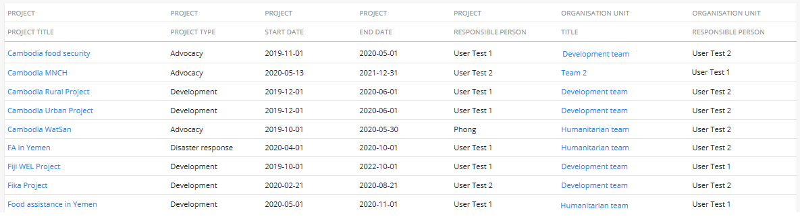
Analyse – the generated report
When the ‘Generate’ button is clicked and the report appears at the bottom of the screen (scroll down to view it), the first row is the name of the table, the second row is the name of the field ticked in the checklist
If entries in the report appear in blue text, these are links to the mentioned page, click on the entry to open it in the same tab, or right click as select ‘Open in new tab’ to open it is a separate tab
Table name
Field name

Slide 6
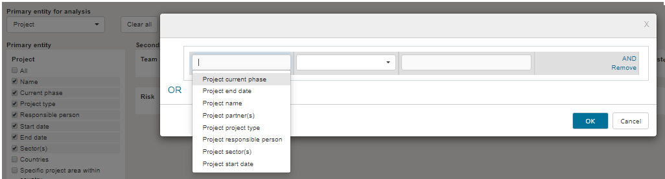
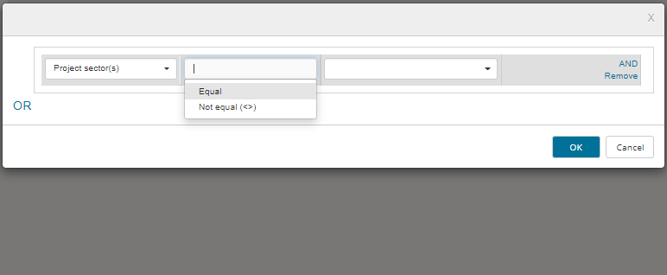
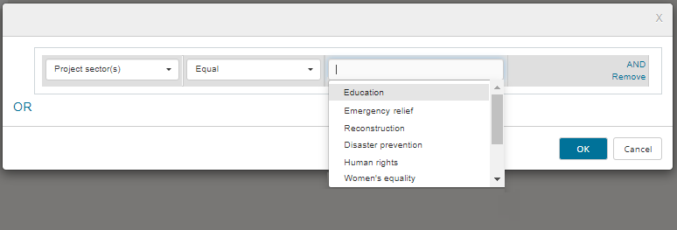
Analyse – Filter
First field: Lists the fields selected (column headings)
- select the field you want to filter on
Second field: The options that appear depend on the field type selected in the first field (more details on next slide)
Third field: This is the list of options within the field being filtered.
Note this might be free text rather than a drop down.

Slide 7
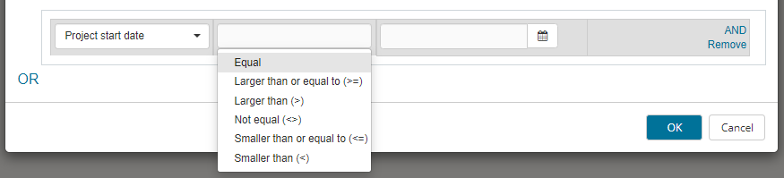
Analyse – Filter (second field differences)
1. If the first field is a drop down field type (such as Project type or Sector)
- second field will be Equal / Not equal
- third field will be the drop down field options
----------------------------------------------------------------------------------------------------------------------
2. If the first field is a number field type (such as a date or a value)
- second field will be numerical specific
- third field will be a date picker or free text to input a number
----------------------------------------------------------------------------------------------------------------------
3. If the first field is a free text field type (such as Project name or Description)
- second field will be ‘Like’
- third field will be free text to input the text
In this case, in the third field the user must type in some text ‘Like’ the text they want to filter
(a drop down will not appear in the third field)

Slide 8
Analyse – Save queries
Users can save queries (incl. filters) to be run again whenever needed
My queries
Queries the individual user has saved, accessible only to that user
Generate the report and add any filters, then click the ‘Save query’ button
Group queries
Queries a user has saved and shared with other users, accessible only to the users selected
Global queries
Administrators can create ‘Global queries’ for all users to access

Slide 9
Analyse – Export to Excel
Export to Excel
The generated results can be exported to Excel for further analysis – once the query is generated, click the ‘Export to Excel’ button
Generate report and email
Good to use for larger queries
The report is generated in the background and then emailed to the user when ready.

